Slide 1
Computer-Assisted Text Analysis for Social Science: Topic Models & Beyond
Ryan Wesslen / Computer Science Department / PhD Program
Qualifying Exam: April 27, 2017

Slide 2
Elevator pitch: why?

Slide 3
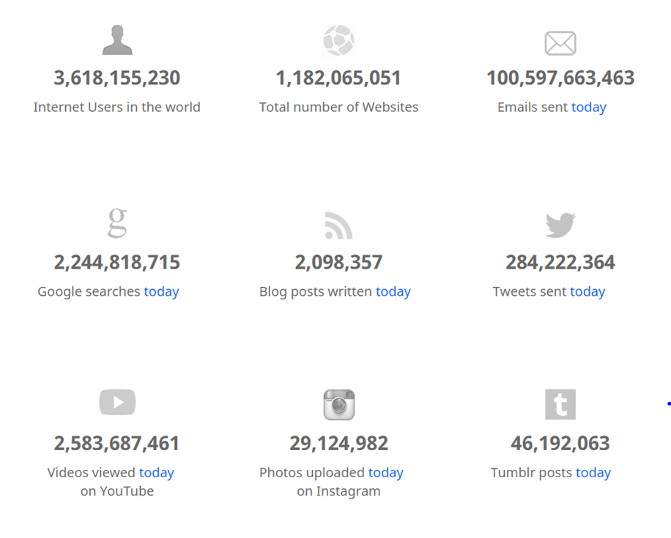
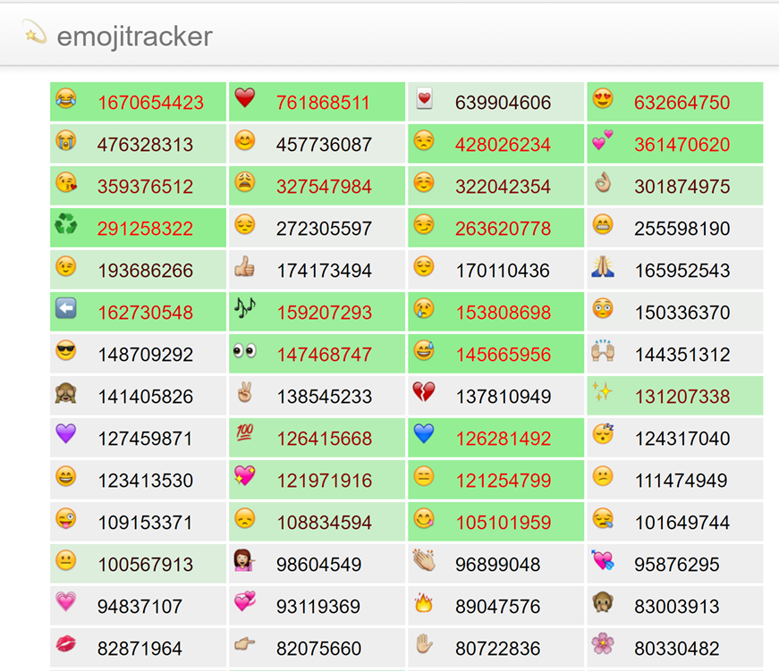
Words, words, words…
http://www.internetlivestats.com/
http://emojitracker.com/

Slide 4
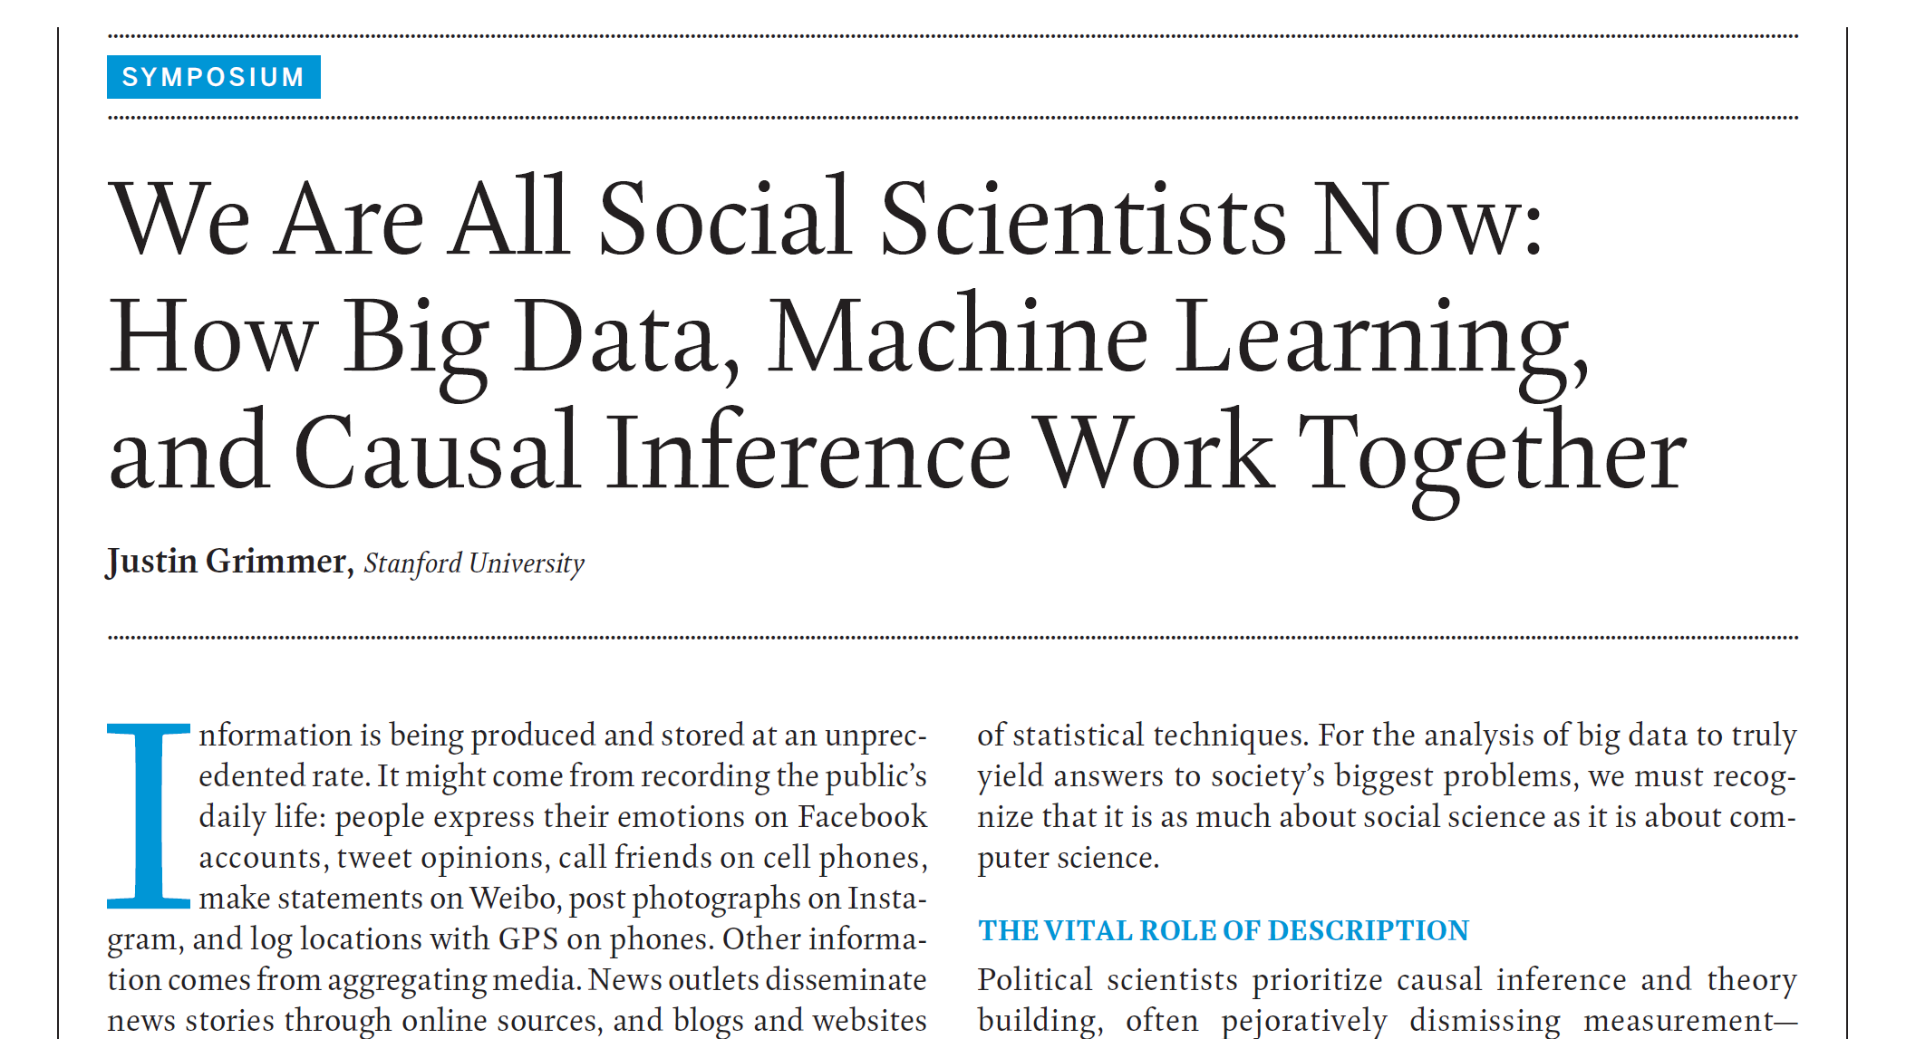
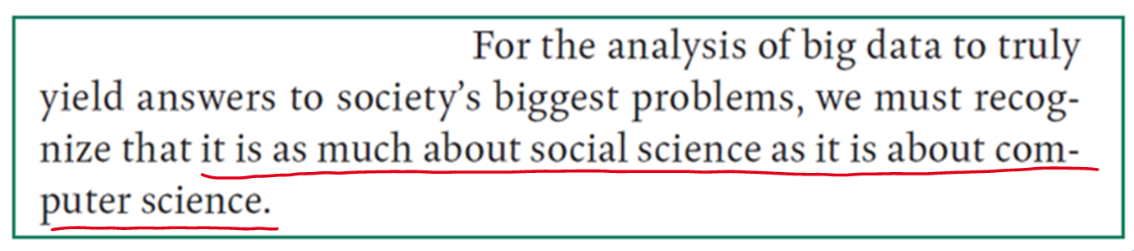
Computational social science

Slide 5
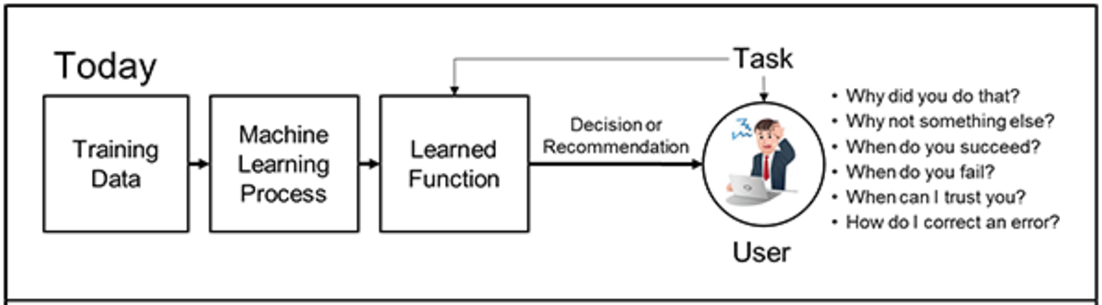
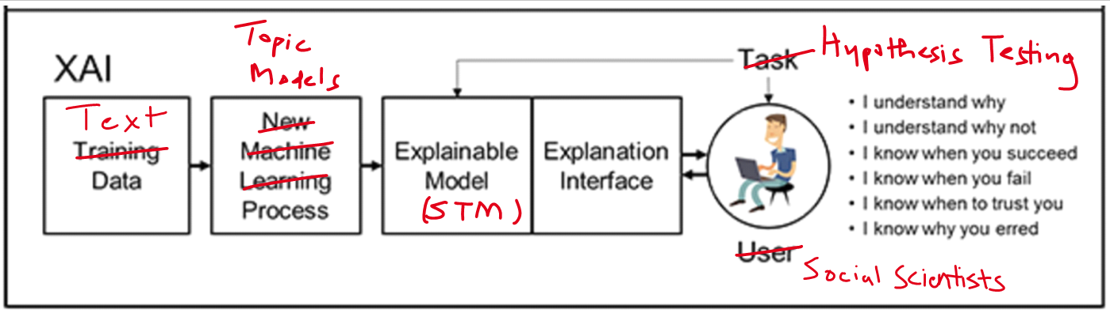
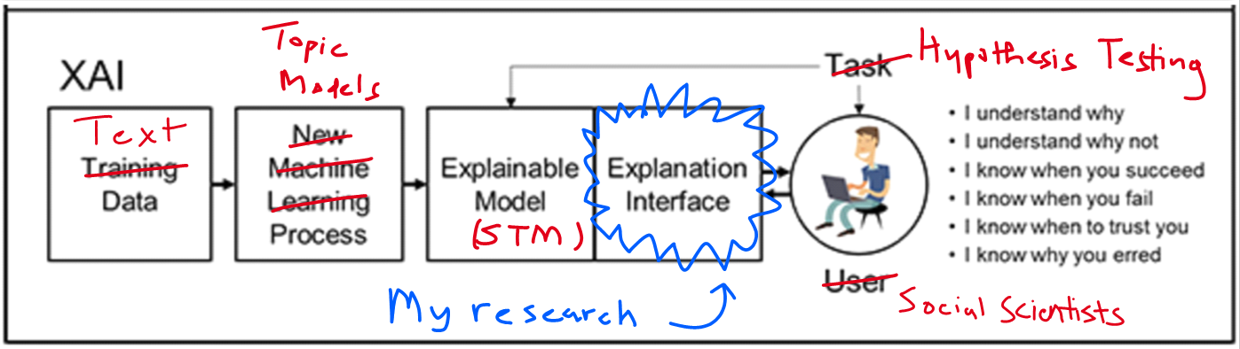
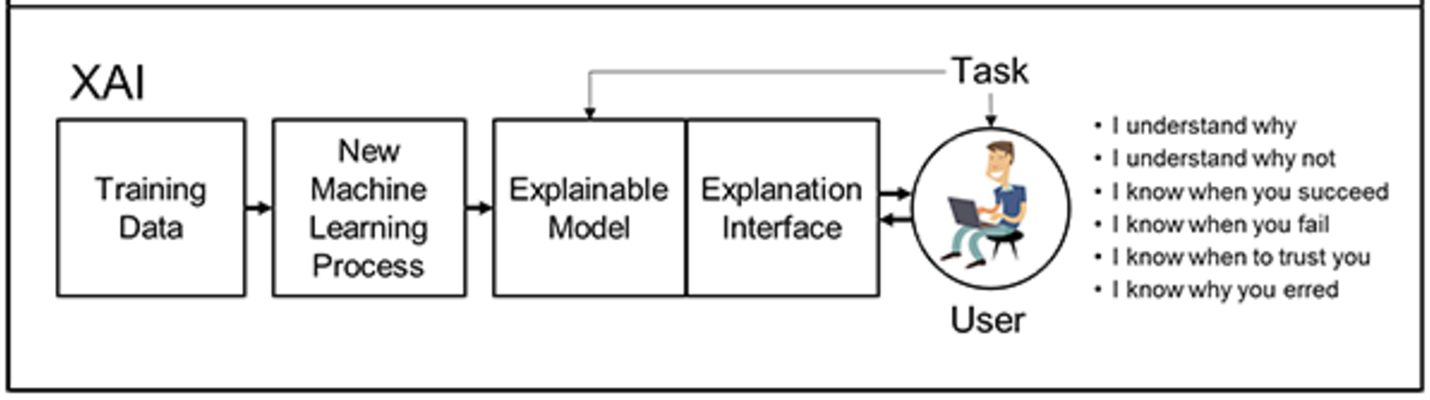
Explainable artificial intelligence
Source: DARPA-BAA-16-53

Slide 6
Overview
Topic Model Evolution
Seminal papers and LDA
Explaining & Applying Topic Models
Interpretation & Evaluation
Visual Analytics
Social Science Research
Applications & Covariates
Methodological Contributions
Future Research

Slide 7
Topic model overview

Slide 8
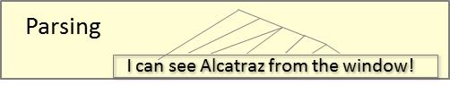
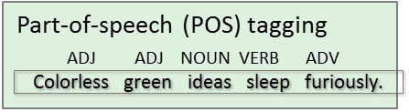
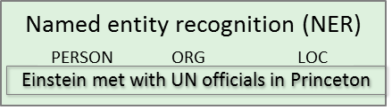
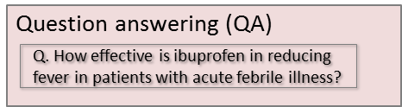
text analysis methods
Text Analysis
Qualitative Analysis (Human coding, Dictionaries)
Count-based (Bag-of-words, vector space)
Natural Language Processing
Supervised
Unsupervised
Topic Modeling
NLP Graphics by Dan Jurafsky
Overgeneralization for illustrative purposes (e.g., omits word embedding, deep learning)

Slide 9
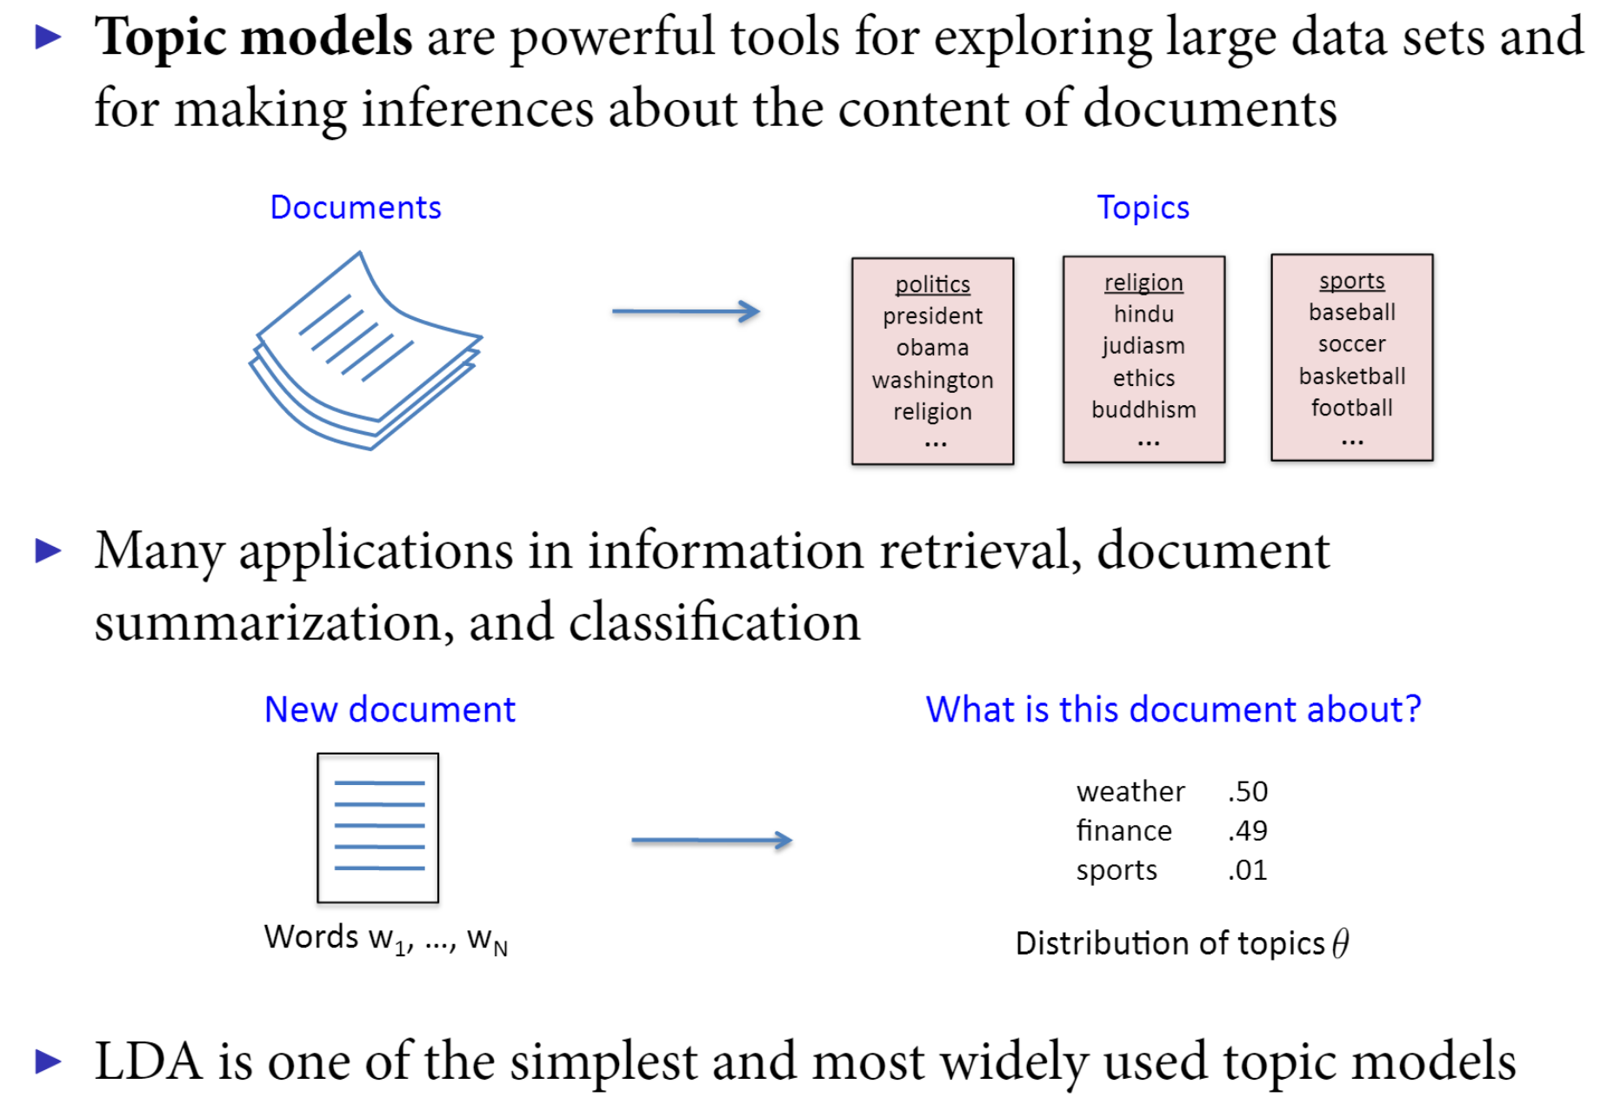
Intuition of Topic modeling
Source: Pablo Barberá

Slide 10
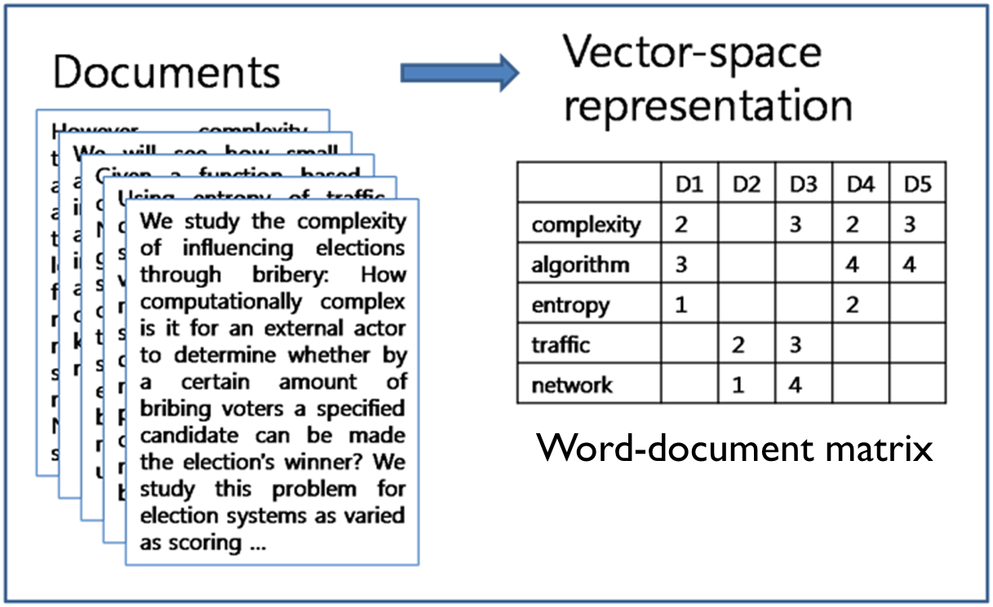
Bag of words assumption
Advantages: (1) simplicity and (2) de Finetti’s theorem (exchangability)

Slide 11
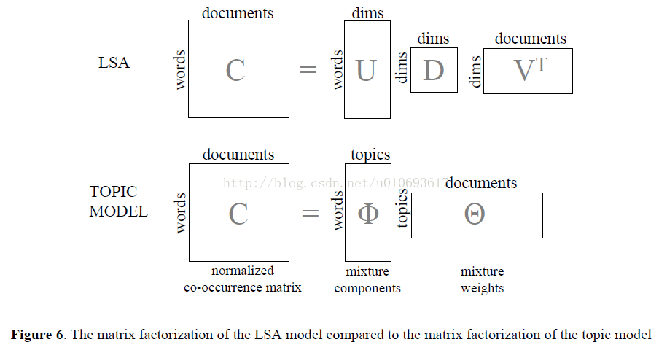
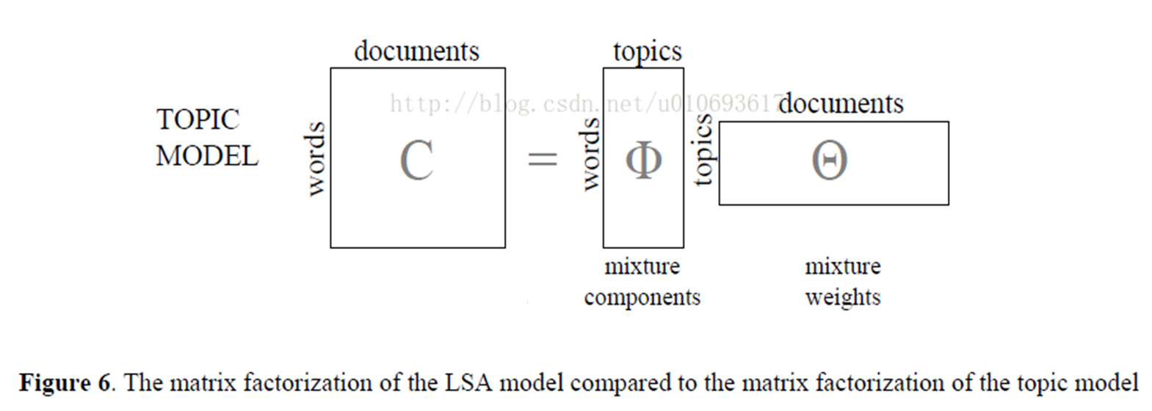
LSA & LDA: matrix factorization

Slide 12
Interpretation of output matrices
Doc-topic | Topic 1 | Topic 2 | Topic 3 | …
Document 1 | 0.1 | 0.4 | 0.25 | …
Document 2 | 0.05 | 0.1 | 0.75 | …
Document 3 | 0.1 | 0.3 | 0.5 | …
Document 4 | 0.6 | 0.1 | 0.05 | …
… | … | … | … | …
Word-topic | Topic 1 | Topic 2 | Topic 3 | …
Urban | 0.1 | 0.01 | 0.02 | …
Cities | 0.05 | 0.02 | 0.01 | …
Visualization | 0.02 | 0.08 | 0.3 | …
 | 0.01 | 0.01 | 0.12 | …
… | … | … | … | …

Slide 13
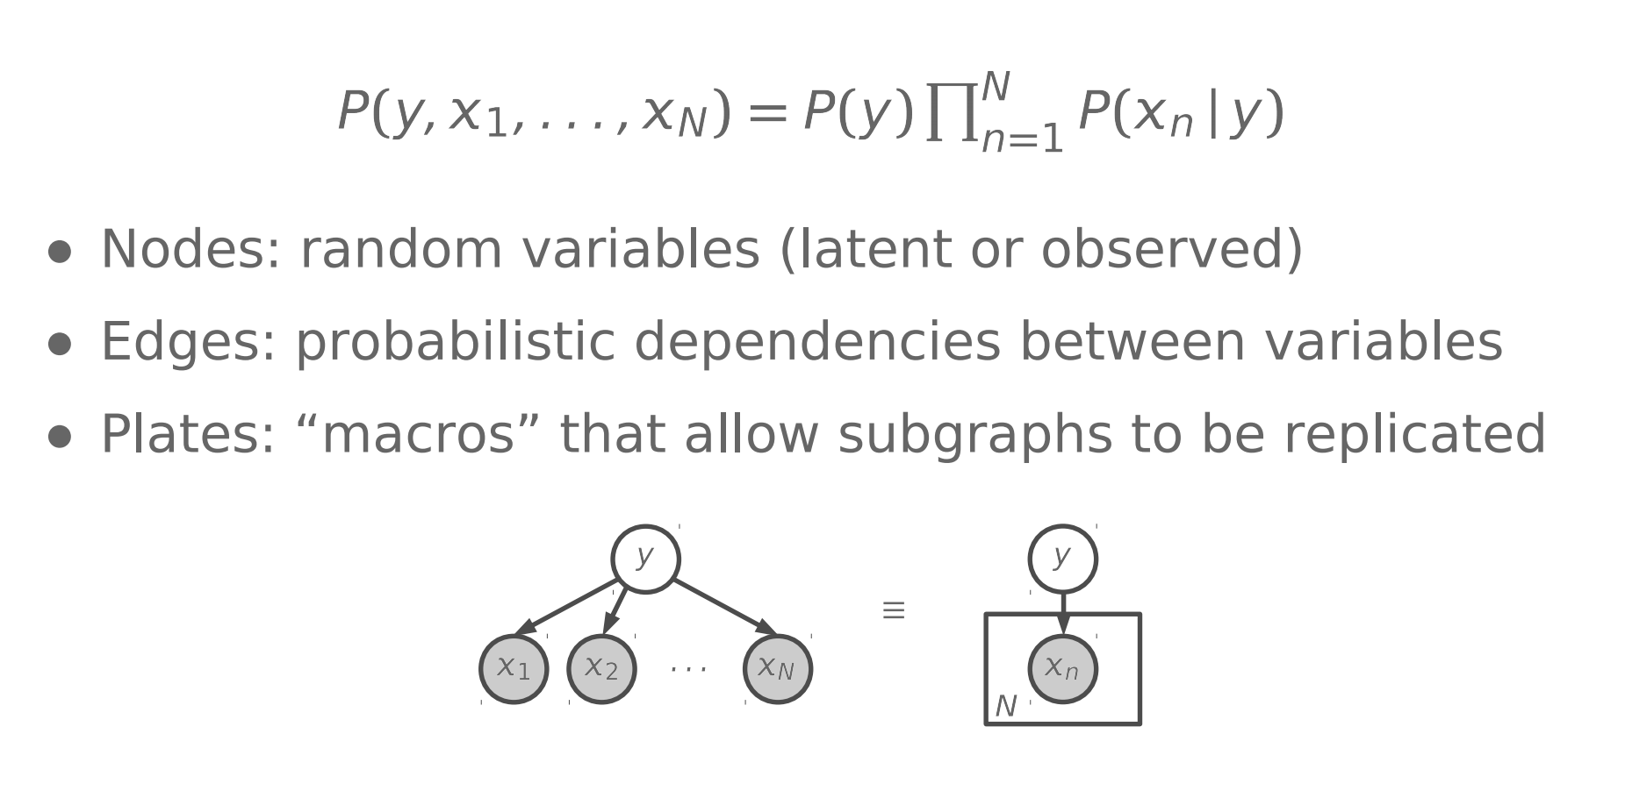
refresh: directed graphical models
Source: Hanna Wallach

Slide 14
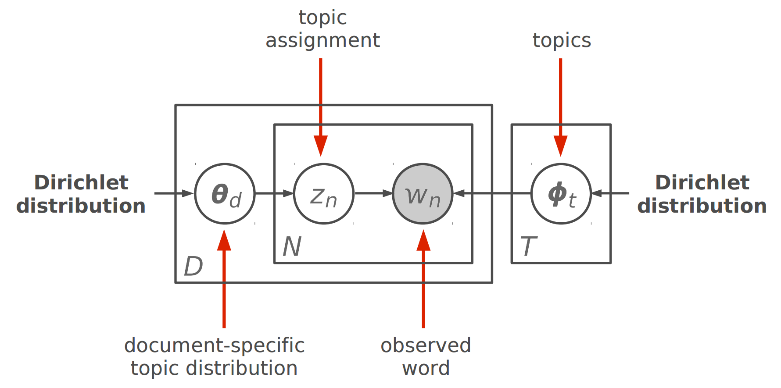
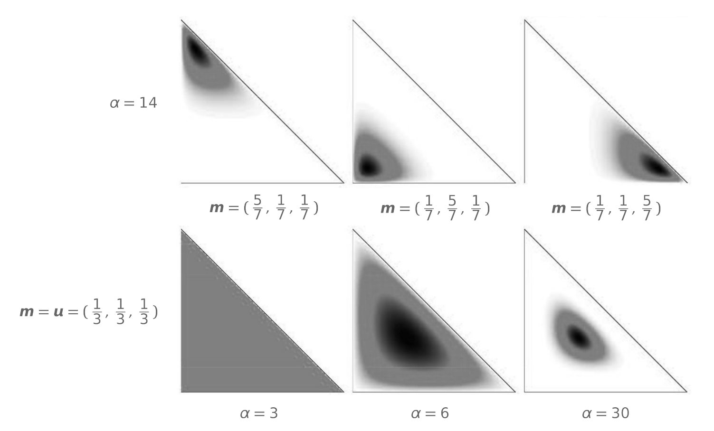
Lda plate notation: Generative model
Blei, Ng, & Jordan 2003, source: Hanna Wallach

Slide 15
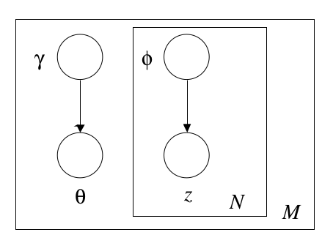
Computational methods
Intractability Inference Problem
Consequence of Bayesian mixture (probabilistic) model
Topic model inference is NP-hard problem (Arora et al. 2012)
Simulation (Sampling-based methods)
Gibbs Sampling, Markov Chain Monte Carlo
Unbiased but potentially slow
Variational Inference (e.g. Mean Field)
Approximation of actual posterior
Converts to optimization problem
Only option for large-scale (online) methods
Variational Inference
Blei, Ng, & Jordan 2003

Slide 16
Explaining & applying topic models

Slide 17
Major questions
How to evaluate models?
How to interpret model (e.g., topics)?
How to visualize topic models?

Slide 18
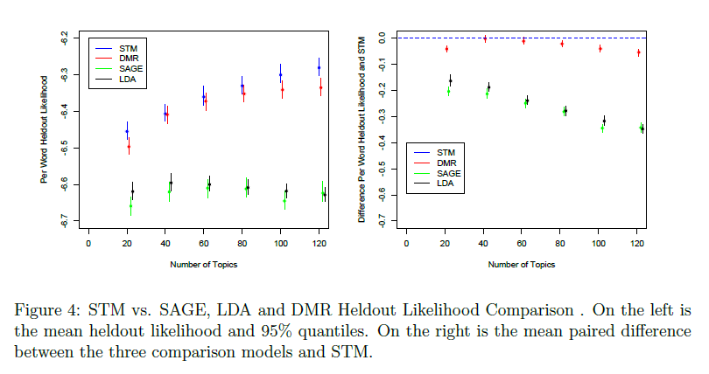
Model evaluation: prediction
Prediction of out-of-sample (heldout) dataset
Perplexity or Log-Likelihood with Cross-Validation
Wallach et al. 2009
Models with higher heldout likelihoods are “better”
Can also be used to determine the optimal number of topics, hyperparameter values.

Slide 19
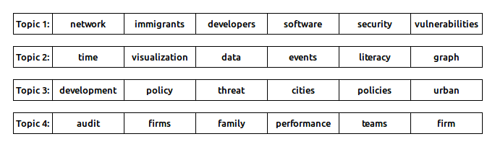
Interpretability-prediction tradeoff
Chang et al (2009) questioned conventional wisdom.
Proposed word-intrusion tasks to find “intruder” word.
Measure of “semantic cohesion”.
UNCC Research Topics “Word Intrusion” Example
Contrary to expectation, evaluation by prediction and topic interpretability can have contradictory results.

Slide 20
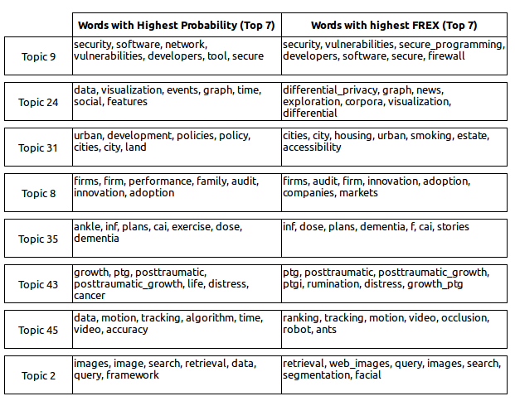
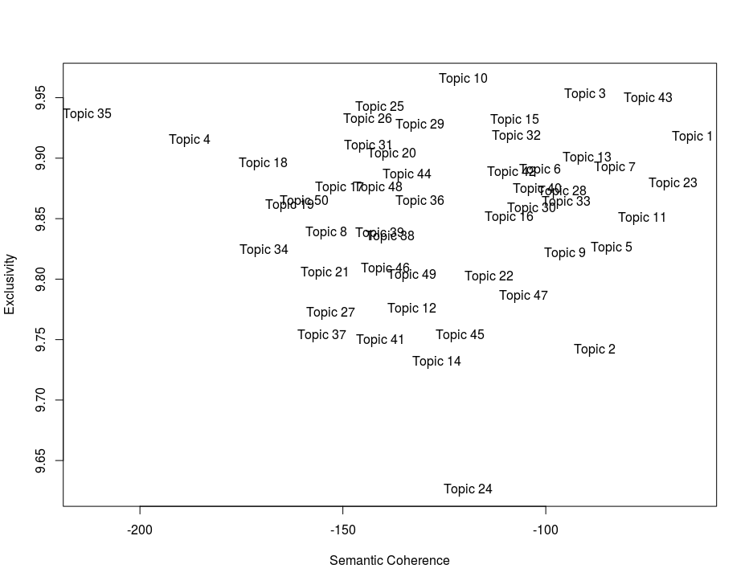
How to interpret topics?
UNCC Research Topics: Exclusivity and Semantic Coherence
Sample UNCC Research Topics
FREX/Exclusivity: Bischof and Airoldi (2012)
Semantic Coherence: Mimno et al. (2011)

Slide 21
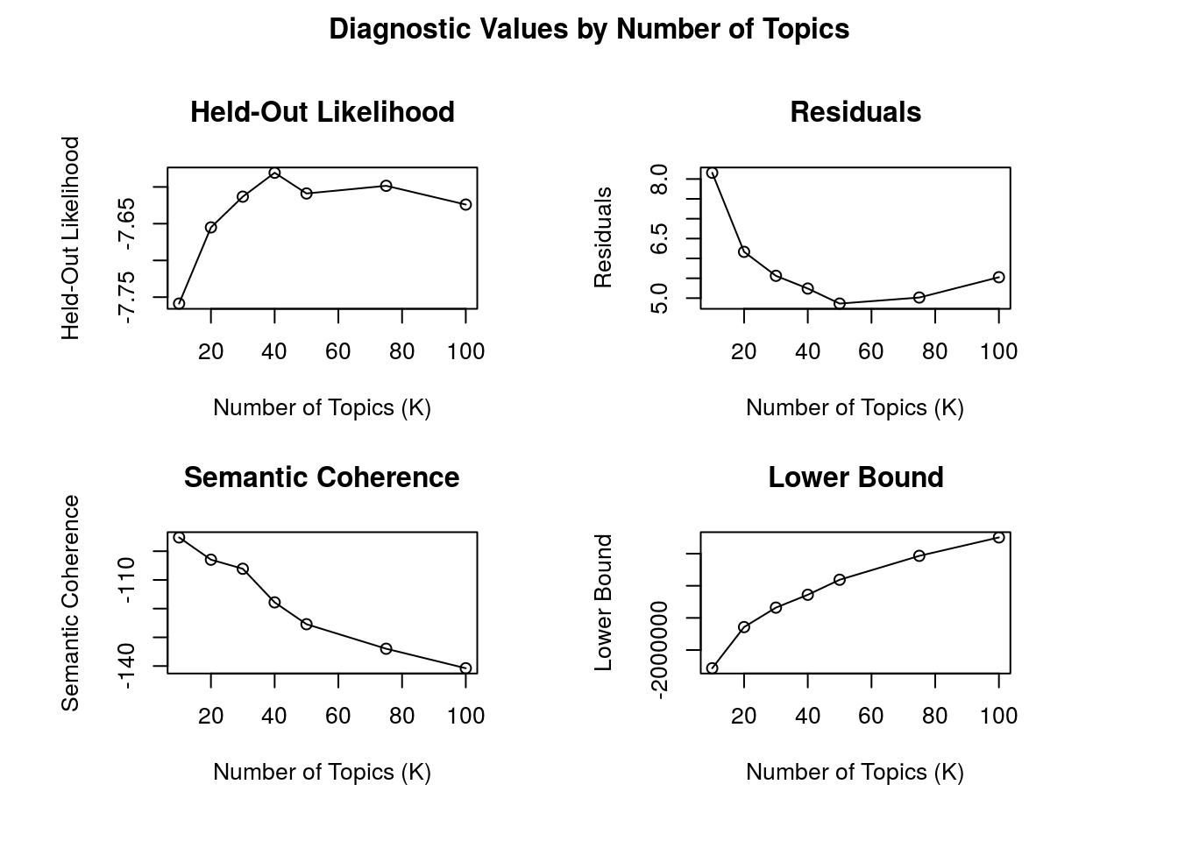
Evaluating topic models (STM)

Slide 22
Need for Interactive visualizations
Topic models’ output is data.
Validation and interpretation are critical.
Need for human-computer interaction (Hu et al. 2014)
Need for visualizations (Dou & Liu 2016)
Time and topic oriented

Slide 23
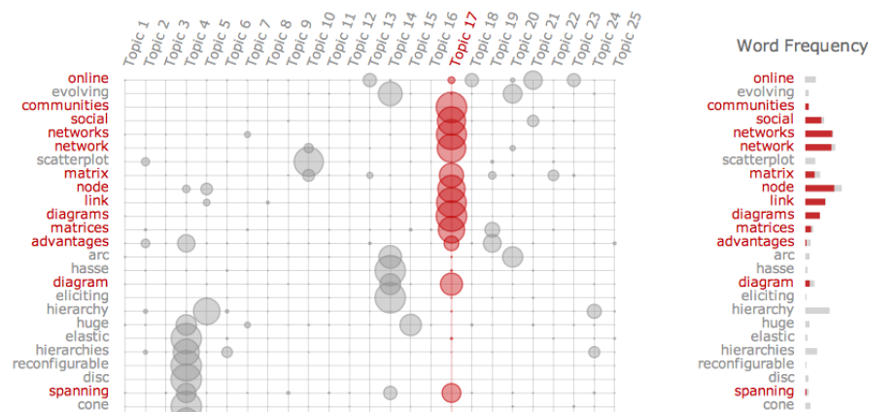
Topic-oriented: chuang et al. 2012

Slide 24
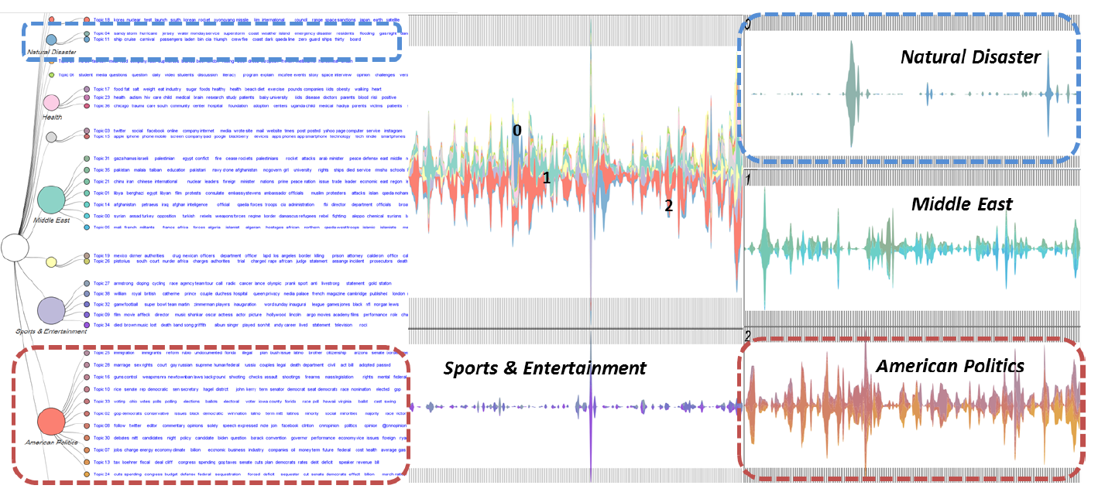
Hierarchical: dou et al. 2011

Slide 25
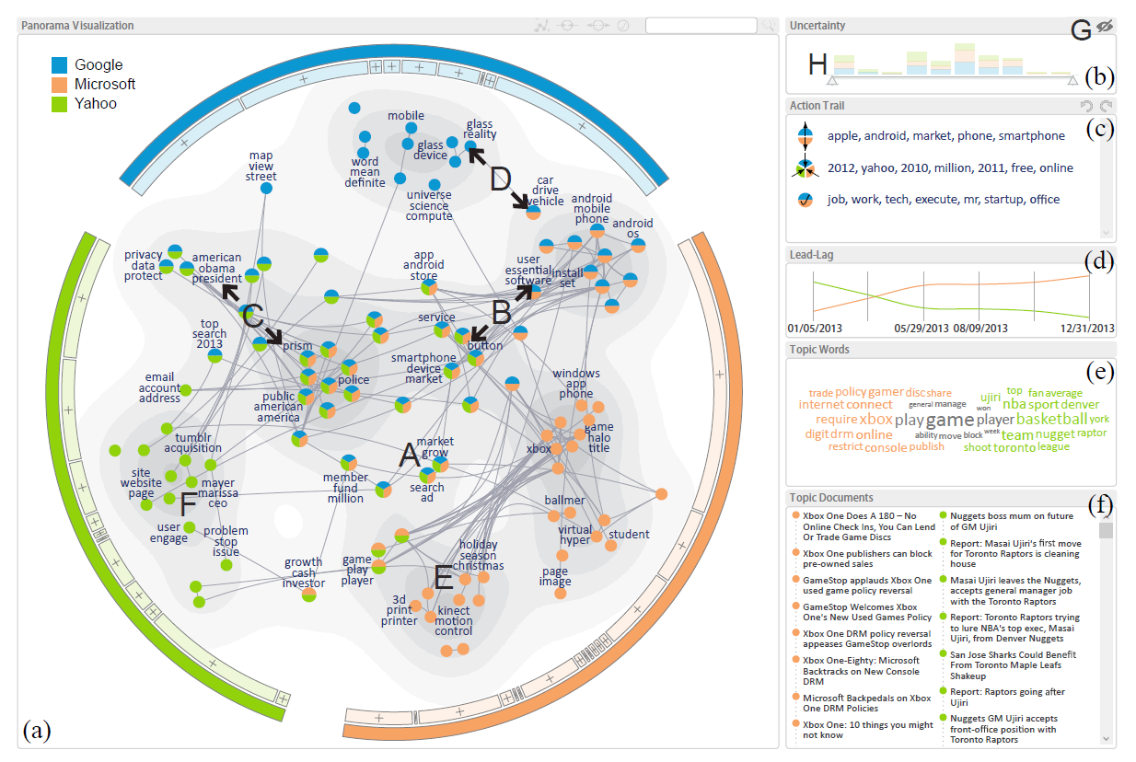
Network-based: wang et al. 2016

Slide 26
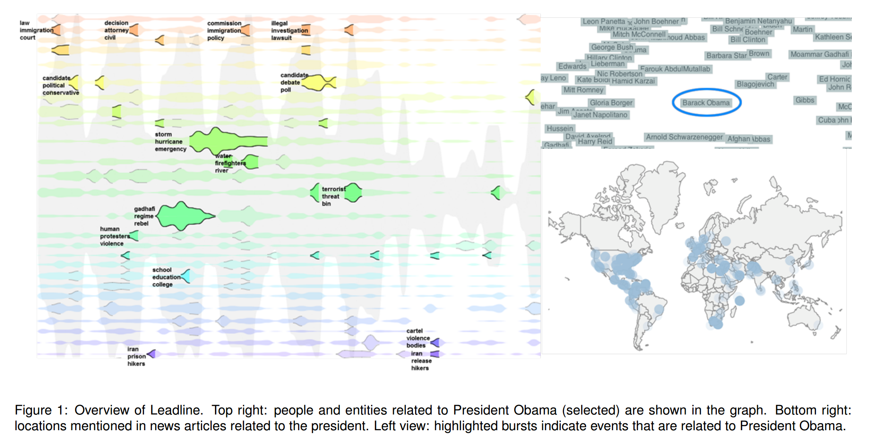
Time-oriented: dou et al. 2012

Slide 27
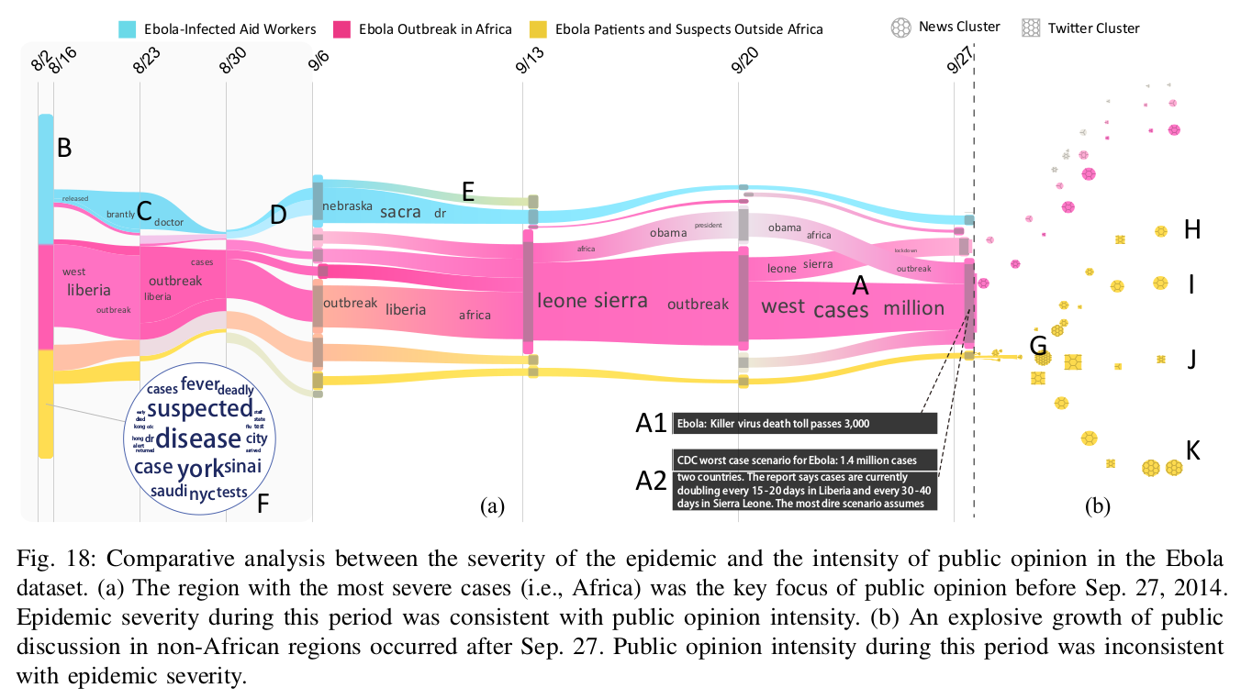
Topicstream: liu et al. 2016

Slide 28
Semantic Coherence & Exclusivity
Social science applications

Slide 29
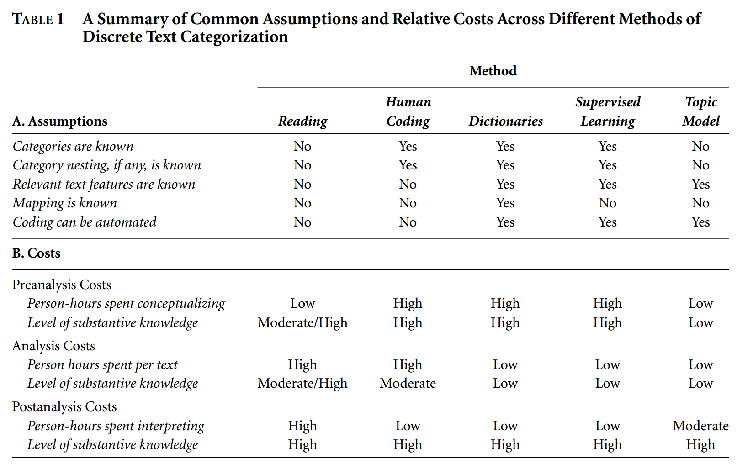
Text analysis for social scientists
Quinn et al. 2010

Slide 30
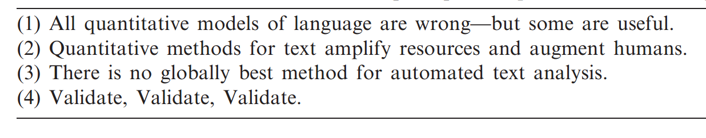
Text as data: grimmer & Stewart 2013
Grimmer & Stewart 2013

Slide 31
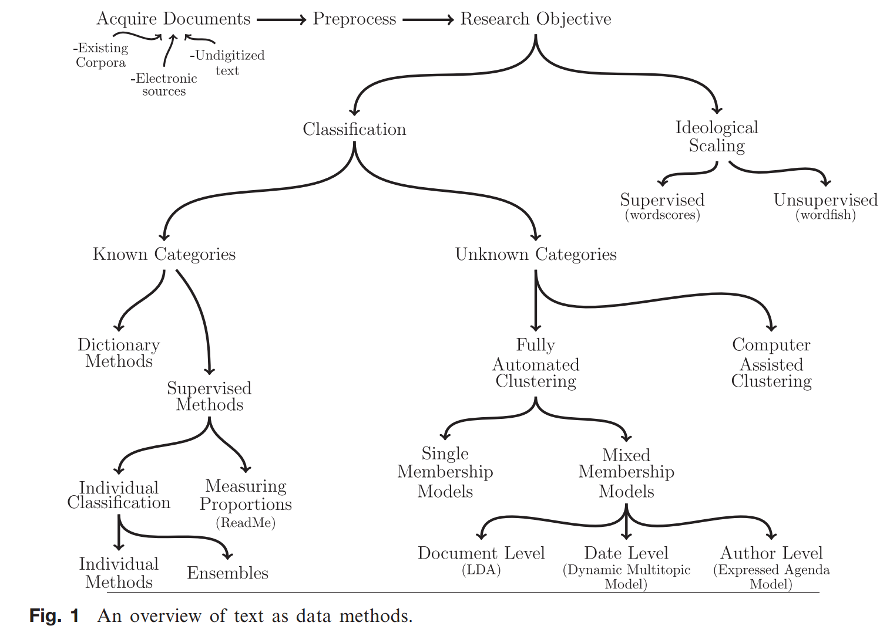
Text as data Methods
Grimmer & Stewart 2013

Slide 32
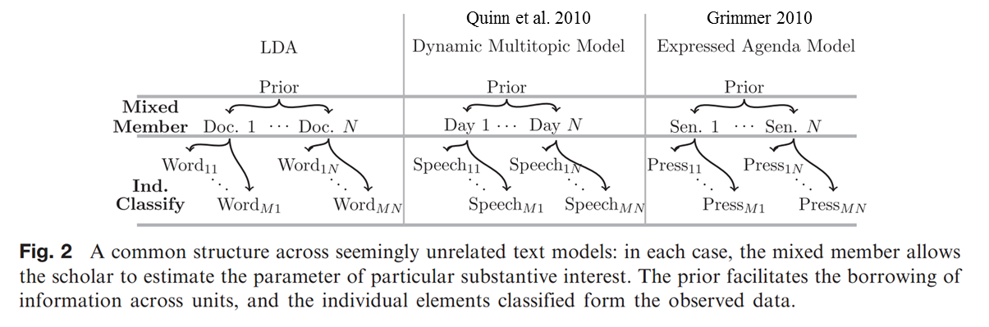
Early social science applications
Grimmer & Stewart 2013

Slide 33
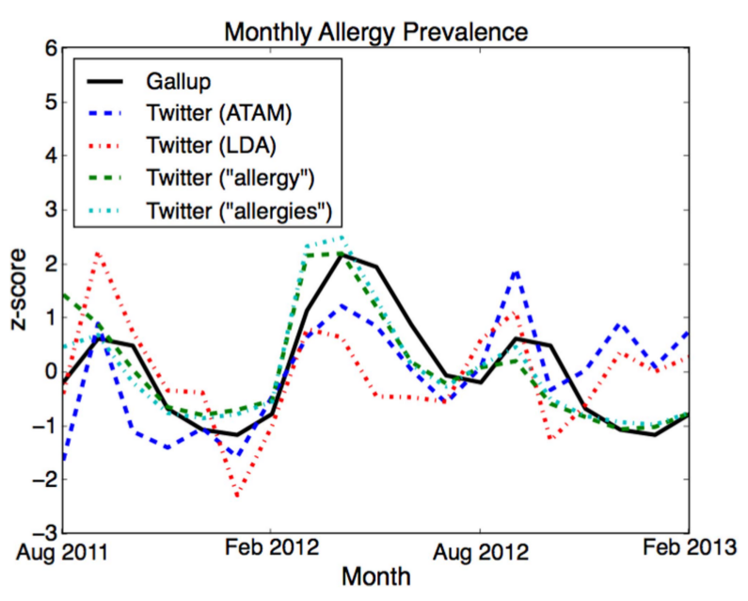
Public health: twitter allergy topics
Paul & Dredze 2014

Slide 34
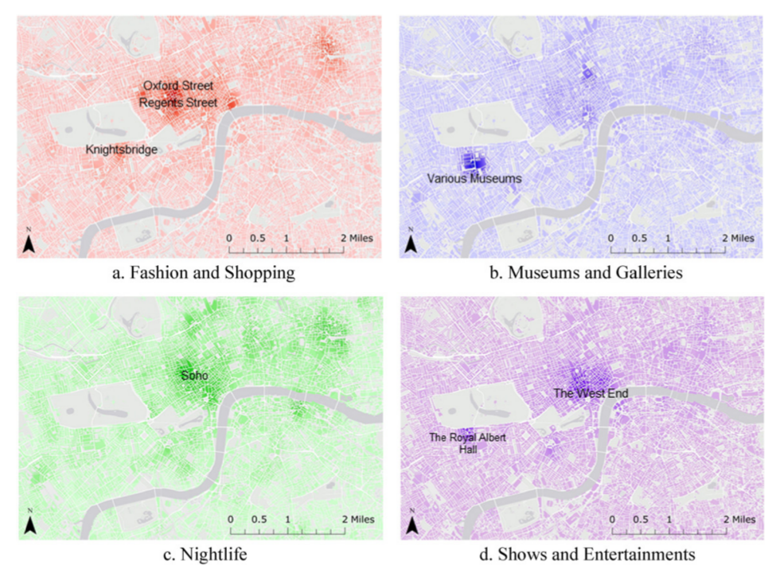
Urban studies: London twitter topics
Lansley & Longley 2016

Slide 35
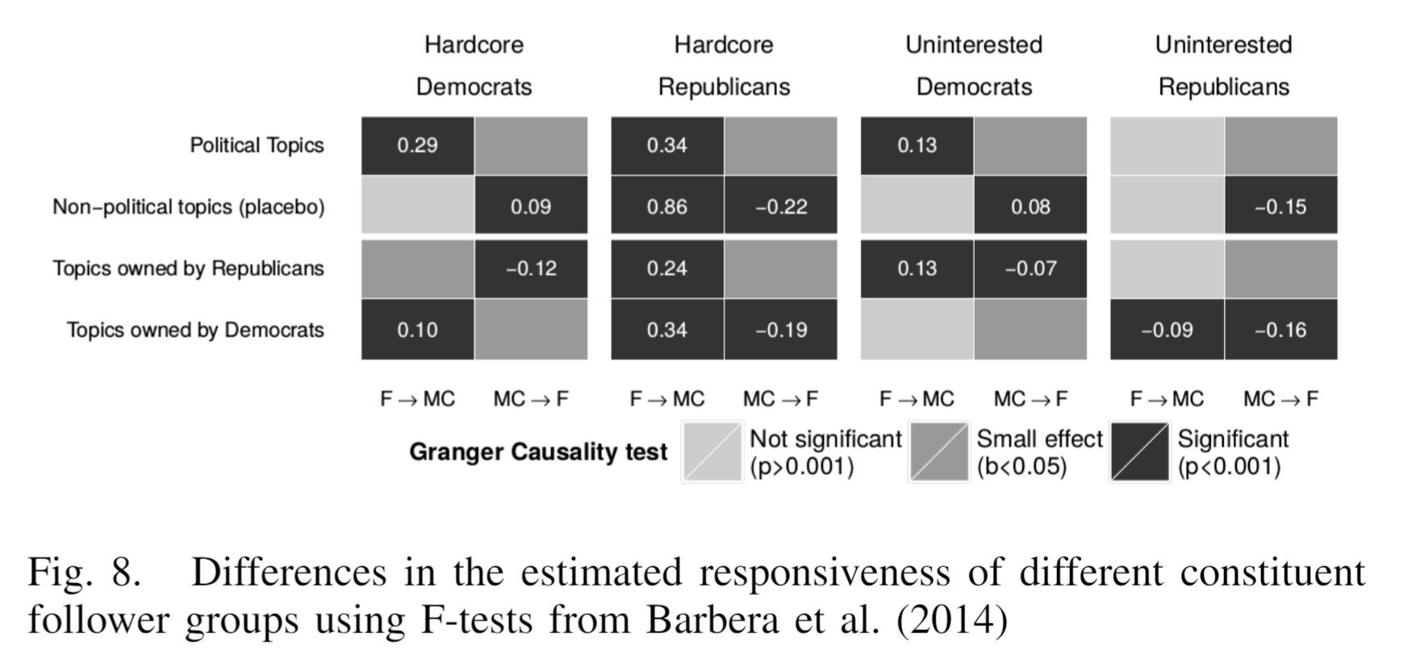
Legislator-constituent twitter

Slide 36
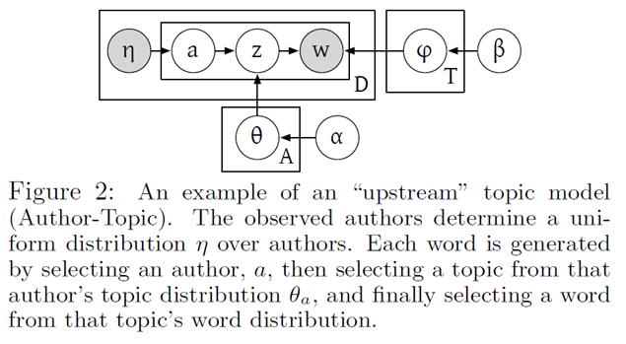
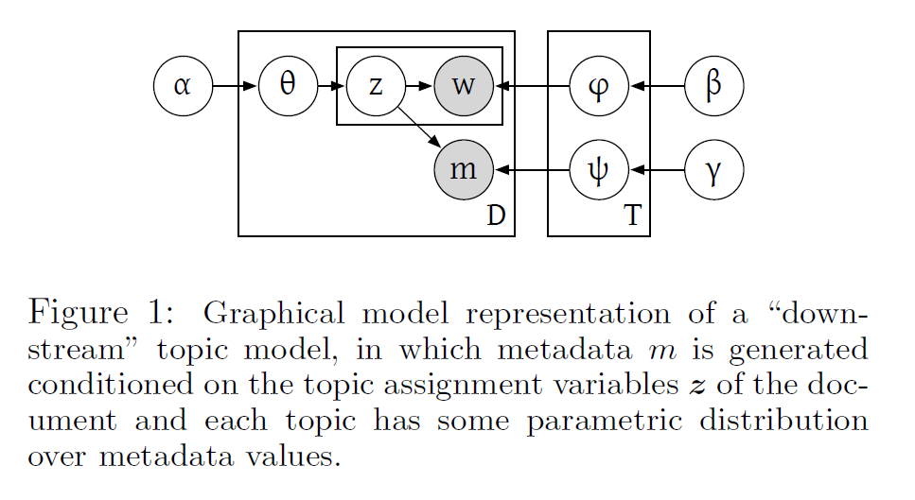
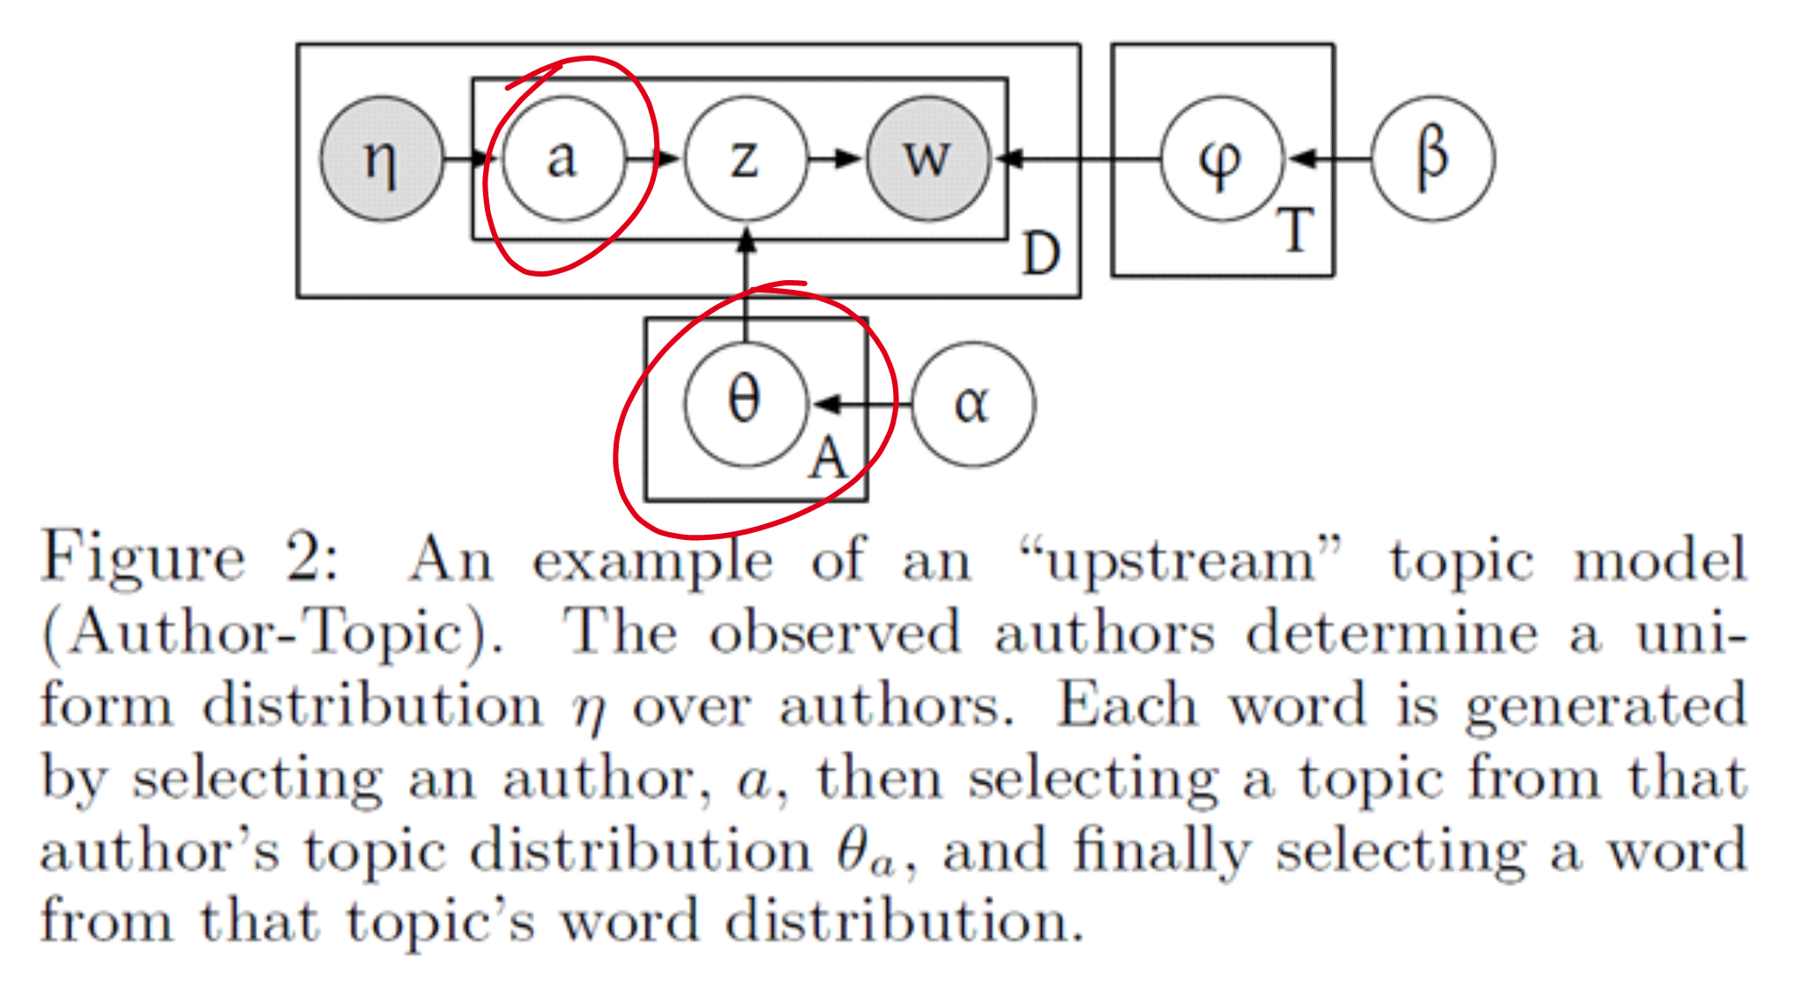
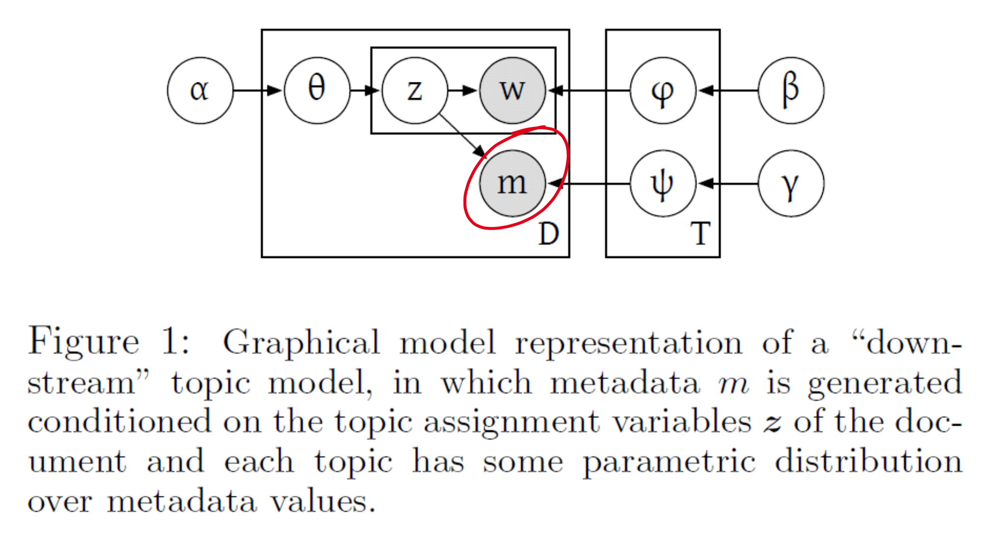
Incorporating covariates
Down-stream:
Metadata is an “output” of the topics (z)
Example: Supervised LDA (Blei & McAuliffe 2007)
Up-stream:
Metadata is an “input” to the topics (z)
Example: Author-Topic (Rosen-Zvi et al., 2004)
Up-stream & Down-stream figures and introduced by Mimno & McCallum (2010)

Slide 37
Structural topic model
STM is a generalization of LDA
Created by political scientists (Roberts, Stewart, Tingley, Airoldi)
Roberts et al. (2013); Roberts et al. (2014); Roberts et al. (2016)
Incorporates document metadata (covariates) into “GLM”
Two types of covariates: prevalence (what) and content (how)
Oversimplification: Y_{Topics} = Constant + b_{p} * X_{prevalence} + b_{c} * X_{content}
R package (stm) using fast Variational EM
Handles multimodality issues (spectral initialization)
Add-ins for topic interpretations (FREX) and model selection

Slide 38
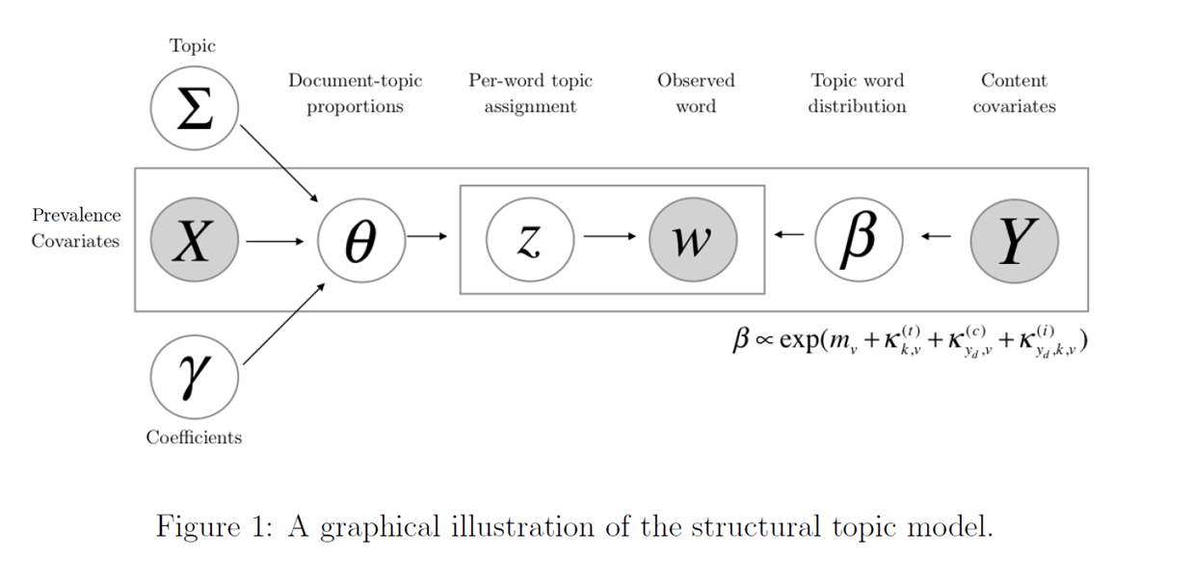
Stm plate notation
Correlated Topic Model (Blei & Lafferty 2007)
Allow topic correlation structure
Dirichlet-Multinomial Regression (Mimno & McCallum 2008)
Covariates that impact “what” topics (prevalence)
SAGE (Eisenstein et al. 2011)
Topic-word computational approximation
Covariates that impact “how” topics (content)
Roberts, Stewart, & Airoldi 2016

Slide 39
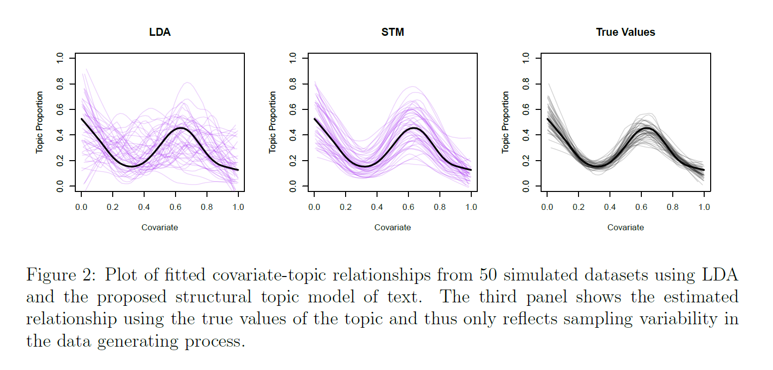
Why use stm? Simulated data example
On average good; but high variance
Better captures covariate relationship
Roberts, Stewart, & Airoldi 2016

Slide 40
Prediction performance
DMR provides STM’s prediction lift
Roberts, Stewart, & Airoldi 2016

Slide 41
Stm case study: Media slant on China
Western and Chinese media slant on China’s Rise
Sample of 11,980 (English) news articles containing the term “China” between 1997 and 2006
Five different international news sources
AFP (France), AP (USA), BBC (British), JEN (Japan), XIN (China)
Run 100 topic STM model
Prevalence covariates: Time (month) and News Source
Content covariate: News Source
Roberts, Stewart, & Airoldi 2016

Slide 42
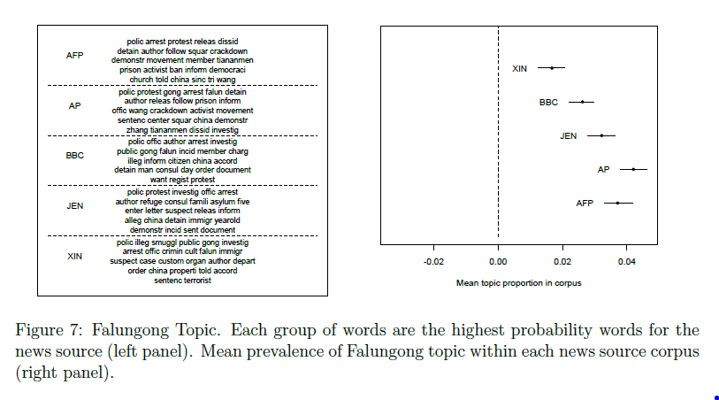
Content & Prevalent covariates
Media outlet as content covariate
Media outlet as prevalence covariate
“Demonstration”
AP / AFP covered topic more often than Xinhua
“Criminal”
Roberts, Stewart, & Airoldi 2016

Slide 43
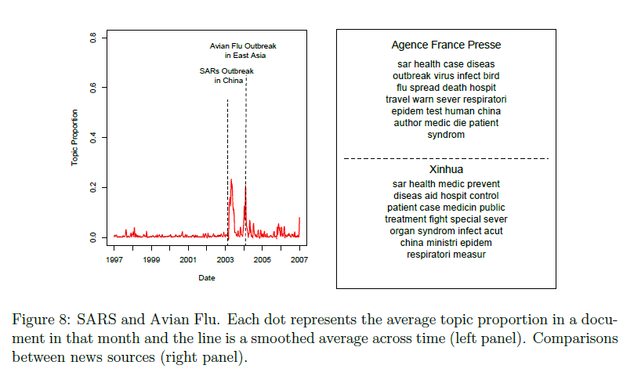
Temporal effect (time as covariate)
Roberts, Stewart, & Airoldi 2016

Slide 44
Problem of multi-modality (stability)
NP hardness of inference gives rise to multi-modality.
Can find local solution – can never be certain found global.
Can lead to whether researcher “did not stumble across the result completely by chance”.
Need to evaluate initialization performance, topic stability and post predictive checks.
Introduce spectral initialization (deterministic) to address issue.
Roberts, Stewart & Tingley 2015

Slide 45
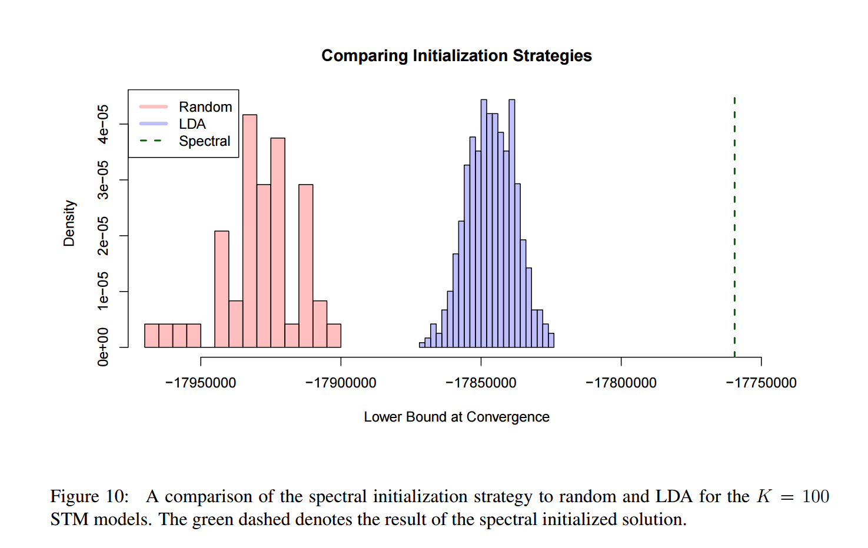
Importance of initialization strategy
Deterministic!
Roberts, Stewart & Tingley 2015

Slide 46
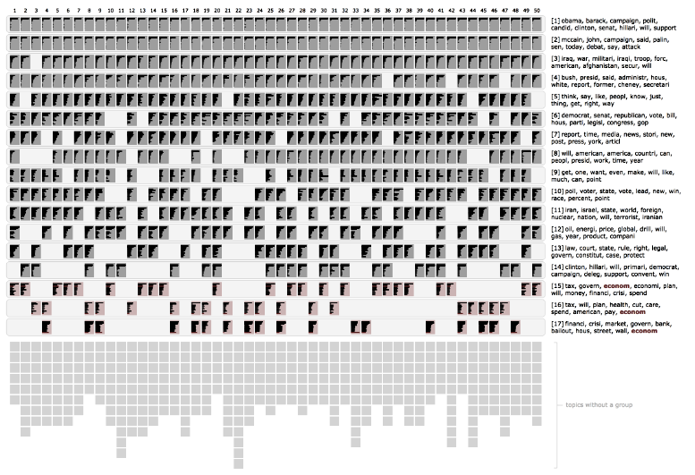
Visualizing multi-modality (Stability)
Chuang et al. 2016

Slide 47
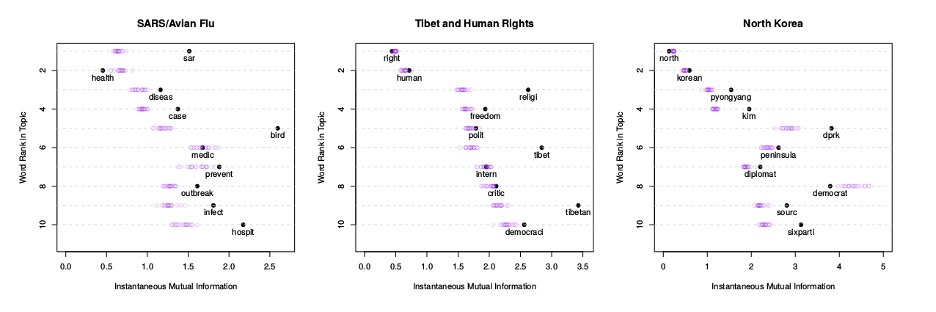
Bayesian Post-predictive checks
Roberts, Stewart, & Airoldi 2016

Slide 48
STM overview
STM provides a generalizable, scalable (more than human coding) framework for measuring causal effects with large collections of text.
The stm R package provides a suite of tools for evaluation, (static) visualization, validation and interpretations.
Problems include zero-sum marginal effects (Fong & Grimmer, 2016), not available in other languages (e.g. Python), scaling to millions of documents (distributed computing).

Slide 49
Semantic Coherence & Exclusivity
Future research

Slide 50
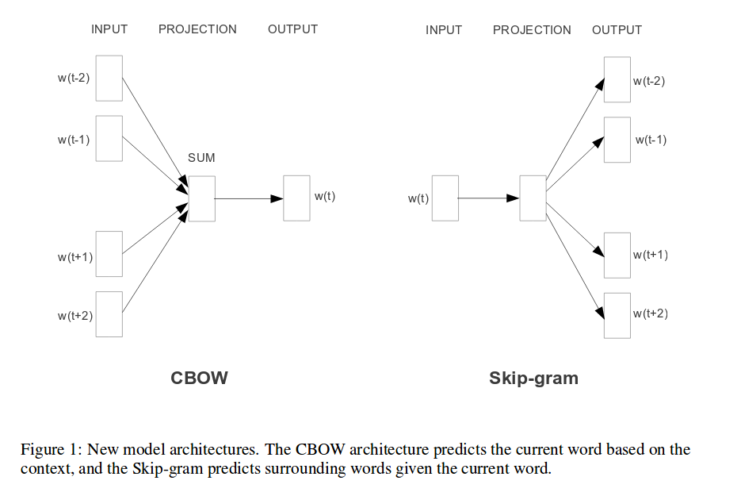
Word embeddings (word2vec)
walk
walk
pitcher
baseball
baseball
pitcher
strikeout
strikeout
home run
home run
Mikolov et al. 2013

Slide 51
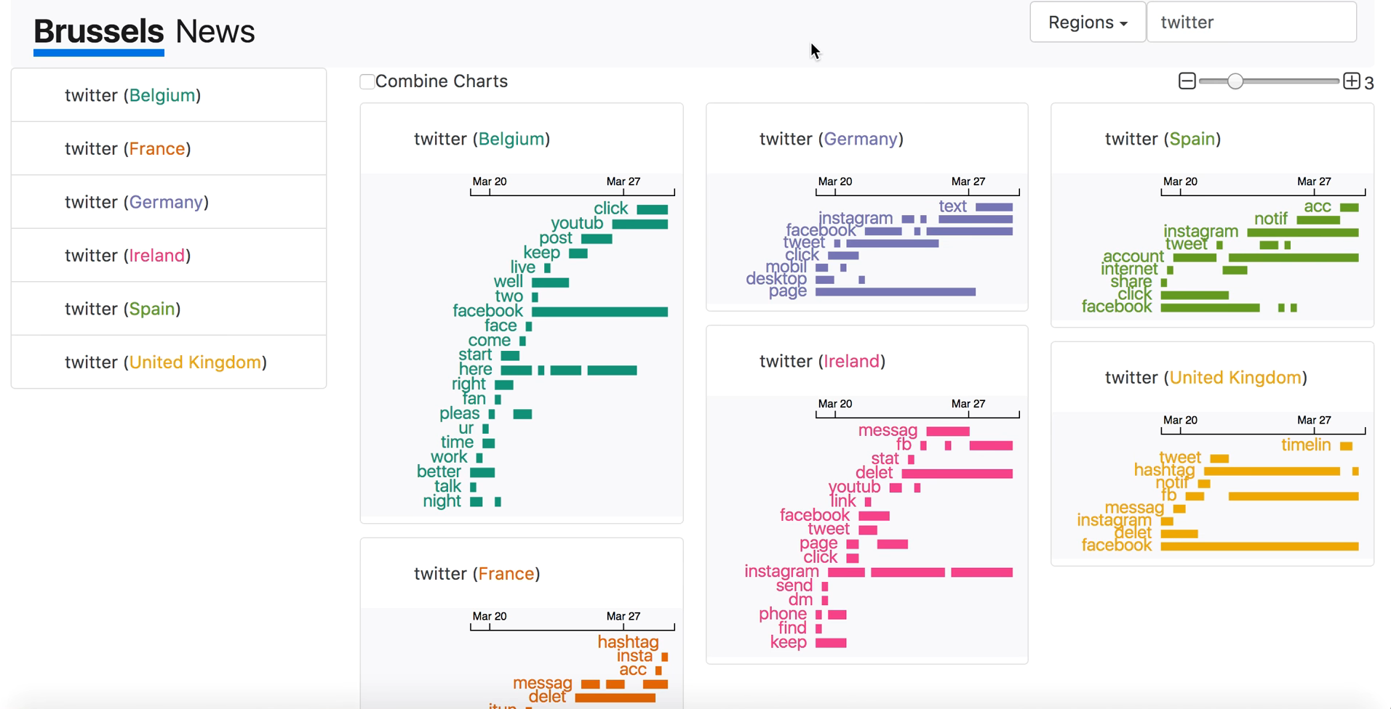
Visualizing spatial-temporal embeddings
Source: Svitlana Volkova, https://www.youtube.com/watch?v=LJb_o_vhpog

Slide 52



Spark & spark streaming

Slide 53


bias in social media
Source: Fred Morstatter

Slide 54
Social scientist Bias in text analysis
Selecting keywords (King, Lam, & Roberts 2016)
Qualitative vs Computer-Assisted text analysis
How to unify both methods?
Anchor and confirmation bias in visual interface systems

Slide 55
Semantic Coherence & Exclusivity
appendix

Slide 56

Deep learning: Image to text
Source: Andrej Karpathy
One problem of many social media applications (Twitter, Facebook) only focus on text, ignoring images.
Deep learning methods now can translate image to text (varying accuracy).
Idea: integrate raw text and image-to-text within topic model framework for enhanced performance.

Slide 57

Deep learning Visualization
Karpathy, Johnson & Fei-Fei 2016

Slide 58

SAGE: Eisenstein et al. 2009

Slide 59


Stm R package

